Slide 1

Sustainable Shipment Systems
Ido Durst, Bobby Tatu, Rickesh Khilnani

Slide 2
Outline
What is happening in the world right now?
Why is it not sustainable?
What does our team do to change that? How?
Dive into code!
Example + Result
Notes:
Outline of presentation:
Shocking facts about Amazon/other companies’ shipments.
Stats, photos
Even tho amazon has delay shipping, no one chooses it.
Conclusion: not an efficient system for sustainability
How do we fix it? Core changes: privacy (for boxes), delay via incentive (transportation); took into account distances, time.
Go into each problem and show the code + explain
Hands-on illustration: pass the computer around judges and ask them to input
Then, show the result (picture of pathway)
Explain why result is efficient/sustainable
***if we can’t do hands-on example, just show a mock up example and present the result.

Slide 3


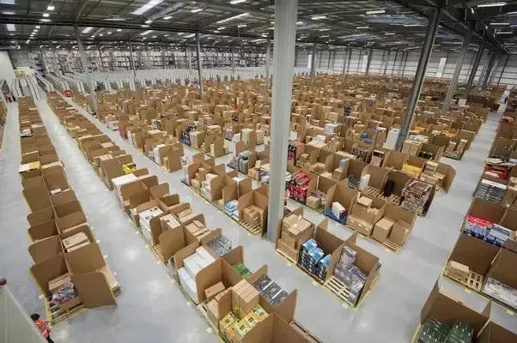
What Is Amazon Doing?
Wasting a ton of boxes!
Amazon ships an average of 608 million packages each year
About 1,600,000 packages a day
At its peak in 2016, Amazon sold 26 million items per day
This means, after calculation, 3,300,300 boxes per day (Quora)
Notes:
Outline of presentation:
Shocking facts about Amazon/other companies’ shipments.
Stats, photos
Even tho amazon has delay shipping, no one chooses it.
Conclusion: not an efficient system for sustainability
How do we fix it? Core changes: privacy (for boxes), delay via incentive (transportation); took into account distances, time.
Go into each problem and show the code + explain
Hands-on illustration: pass the computer around judges and ask them to input
Then, show the result (picture of pathway)
Explain why result is efficient/sustainable
***if we can’t do hands-on example, just show a mock up example and present the result.

Slide 4
What Is Amazon Doing?
Sustainability Consequences!
In 2016, transportation overtook power plants as top producer of carbon dioxide emissions (Vox)
25% of transportation vehicles are trucks
“Last mile” (distribution center to destination)
WE BUY MORE STUFF
Have to design a SUSTAINABLE shipment system for our growing needs!
Notes:
Outline of presentation:
Shocking facts about Amazon/other companies’ shipments.
Stats, photos
Even tho amazon has delay shipping, no one chooses it.
Conclusion: not an efficient system for sustainability
How do we fix it? Core changes: privacy (for boxes), delay via incentive (transportation); took into account distances, time.
Go into each problem and show the code + explain
Hands-on illustration: pass the computer around judges and ask them to input
Then, show the result (picture of pathway)
Explain why result is efficient/sustainable
***if we can’t do hands-on example, just show a mock up example and present the result.

Slide 5
“Obviously, the highest type of efficiency is that which can utilize existing material to the best advantage”
Jawaharlal Nehru, first Prime Minister of India

Slide 6
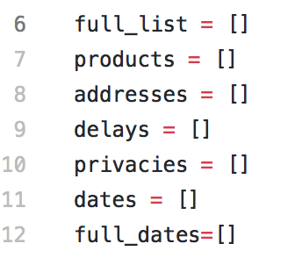
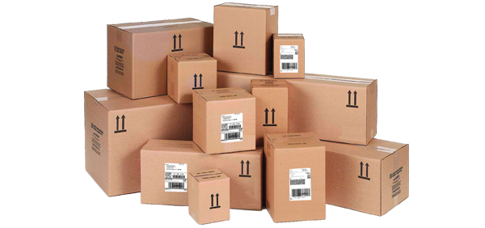
What Are We Doing?
Creating A Sustainable Shipment System!
Organizing online orders in order that reduces :
Amount of incoming/outgoing boxes
Distance traveled
The system will take grouped data of similar order times, locations, and other factors
Output a most efficient list (route) of where to go, what boxes to take, and at what times.
Notes:
Outline of presentation:
Shocking facts about Amazon/other companies’ shipments.
Stats, photos
Even tho amazon has delay shipping, no one chooses it.
Conclusion: not an efficient system for sustainability
How do we fix it? Core changes: privacy (for boxes), delay via incentive (transportation); took into account distances, time.
Go into each problem and show the code + explain
Hands-on illustration: pass the computer around judges and ask them to input
Then, show the result (picture of pathway)
Explain why result is efficient/sustainable
***if we can’t do hands-on example, just show a mock up example and present the result.

Slide 7

Why Are We Doing This?
To Help Mother Earth!
Reduce amount of pollution due to excessive shipments driving distances
Reduce carbon footprint (if implemented on a national scale)
Create a more efficient shipment system to benefit consumers and growing needs of sustainability

Slide 8
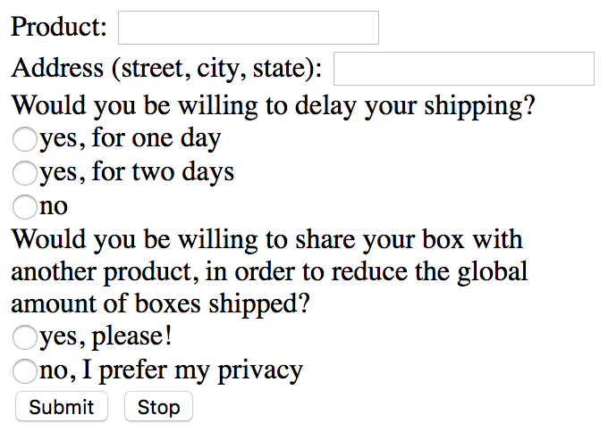

How Are We Fixing This?
Limiting Waste!
If privacy unnecessary, and shipments go to the same address, they can share the box!
If possible, delay arrival times (By one or two days)
encourage through an incentive (unlike Amazon)
Calculate distances and times to get the most efficient route
Amazon but better!
Notes:
Bobby
Outline of presentation:
Shocking facts about Amazon/other companies’ shipments.
Stats, photos
Even tho amazon has delay shipping, no one chooses it.
Conclusion: not an efficient system for sustainability
How do we fix it? Core changes: privacy (for boxes), delay via incentive (transportation); took into account distances, time.
Go into each problem and show the code + explain
Hands-on illustration: pass the computer around judges and ask them to input
Then, show the result (picture of pathway)
Explain why result is efficient/sustainable
***if we can’t do hands-on example, just show a mock up example and present the result.

Slide 9
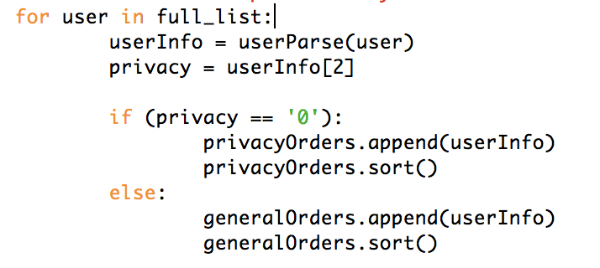
Privacy
Let’s Get Efficient!
We ask whether or not user wants privacy
If user does: privacy orders
If user does not: general orders
Notes:
Outline of presentation:
Shocking facts about Amazon/other companies’ shipments.
Stats, photos
Even tho amazon has delay shipping, no one chooses it.
Conclusion: not an efficient system for sustainability
How do we fix it? Core changes: privacy (for boxes), delay via incentive (transportation); took into account distances, time.
Go into each problem and show the code + explain
Hands-on illustration: pass the computer around judges and ask them to input
Then, show the result (picture of pathway)
Explain why result is efficient/sustainable
***if we can’t do hands-on example, just show a mock up example and present the result.

Slide 10
Privacy
Let’s Get Efficient!
General Orders:
Look for similar dates and addresses
If same, can share the box!
Notes:
Outline of presentation:
Shocking facts about Amazon/other companies’ shipments.
Stats, photos
Even tho amazon has delay shipping, no one chooses it.
Conclusion: not an efficient system for sustainability
How do we fix it? Core changes: privacy (for boxes), delay via incentive (transportation); took into account distances, time.
Go into each problem and show the code + explain
Hands-on illustration: pass the computer around judges and ask them to input
Then, show the result (picture of pathway)
Explain why result is efficient/sustainable
***if we can’t do hands-on example, just show a mock up example and present the result.

Slide 11

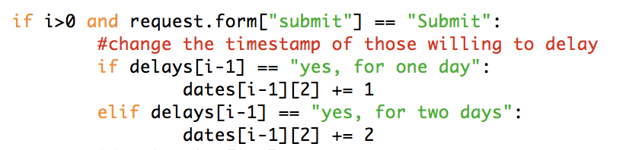
Delaying Arrival Times
Let’s Get Efficient!
We ask if user is willing to delay by one or two days
If willing by one, we increase the timestamp day by one
If willing by two, we increase the timestamp day by two
Notes:
Outline of presentation:
Shocking facts about Amazon/other companies’ shipments.
Stats, photos
Even tho amazon has delay shipping, no one chooses it.
Conclusion: not an efficient system for sustainability
How do we fix it? Core changes: privacy (for boxes), delay via incentive (transportation); took into account distances, time.
Go into each problem and show the code + explain
Hands-on illustration: pass the computer around judges and ask them to input
Then, show the result (picture of pathway)
Explain why result is efficient/sustainable
***if we can’t do hands-on example, just show a mock up example and present the result.

Slide 12
Delaying Arrival Times
Let’s Get Efficient!
Then, we have lists of all orders of:
That day
People willing to wait to have their orders shipped that day
Notes:
Outline of presentation:
Shocking facts about Amazon/other companies’ shipments.
Stats, photos
Even tho amazon has delay shipping, no one chooses it.
Conclusion: not an efficient system for sustainability
How do we fix it? Core changes: privacy (for boxes), delay via incentive (transportation); took into account distances, time.
Go into each problem and show the code + explain
Hands-on illustration: pass the computer around judges and ask them to input
Then, show the result (picture of pathway)
Explain why result is efficient/sustainable
***if we can’t do hands-on example, just show a mock up example and present the result.

Slide 13
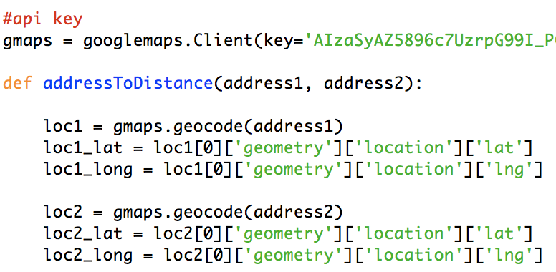
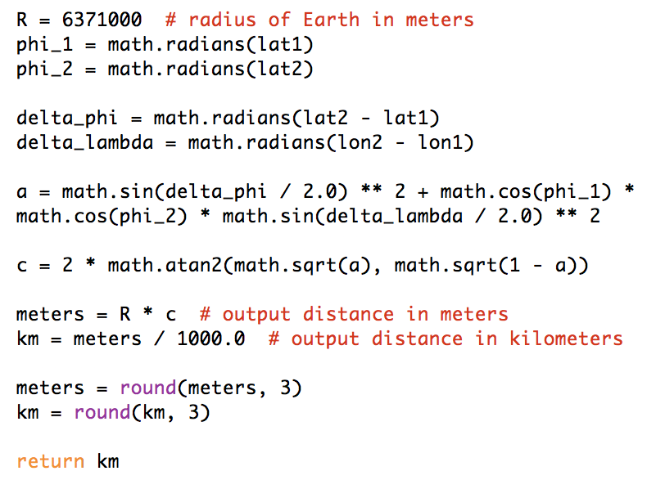
Distance and Path
Let’s Get Efficient!
Using Google Maps GeoCoding API, we find the longitudes and latitudes of each address
We can find distance between all addresses through the Haversine Formula!
Notes:
Bobby
Outline of presentation:
Shocking facts about Amazon/other companies’ shipments.
Stats, photos
Even tho amazon has delay shipping, no one chooses it.
Conclusion: not an efficient system for sustainability
How do we fix it? Core changes: privacy (for boxes), delay via incentive (transportation); took into account distances, time.
Go into each problem and show the code + explain
Hands-on illustration: pass the computer around judges and ask them to input
Then, show the result (picture of pathway)
Explain why result is efficient/sustainable
***if we can’t do hands-on example, just show a mock up example and present the result.

Slide 14
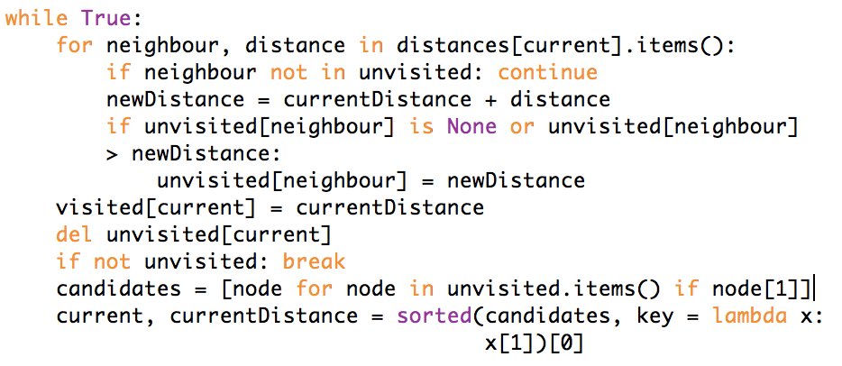
Distance and Path
Let’s Get Efficient!
Then, starting at our base:
Check distances to all other points
Choose shortest
From next chosen point:
Check distances to all other points, excluding those already checked
Choose shortest
Notes:
Outline of presentation:
Shocking facts about Amazon/other companies’ shipments.
Stats, photos
Even tho amazon has delay shipping, no one chooses it.
Conclusion: not an efficient system for sustainability
How do we fix it? Core changes: privacy (for boxes), delay via incentive (transportation); took into account distances, time.
Go into each problem and show the code + explain
Hands-on illustration: pass the computer around judges and ask them to input
Then, show the result (picture of pathway)
Explain why result is efficient/sustainable
***if we can’t do hands-on example, just show a mock up example and present the result.

Slide 15
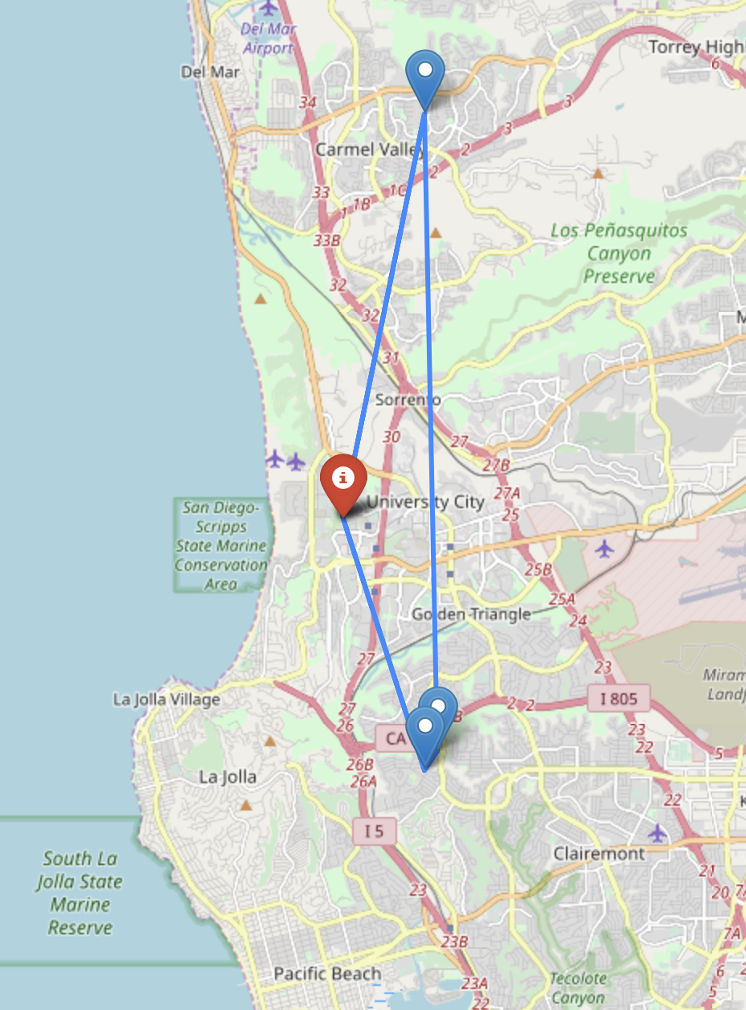
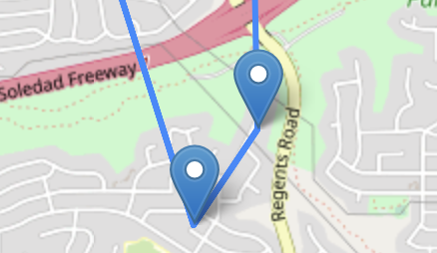
Distance and Path
Let’s Get Efficient!
Repeatedly until back at base
Voila! Shortest path
Notes:
Outline of presentation:
Shocking facts about Amazon/other companies’ shipments.
Stats, photos
Even tho amazon has delay shipping, no one chooses it.
Conclusion: not an efficient system for sustainability
How do we fix it? Core changes: privacy (for boxes), delay via incentive (transportation); took into account distances, time.
Go into each problem and show the code + explain
Hands-on illustration: pass the computer around judges and ask them to input
Then, show the result (picture of pathway)
Explain why result is efficient/sustainable
***if we can’t do hands-on example, just show a mock up example and present the result.

Slide 16
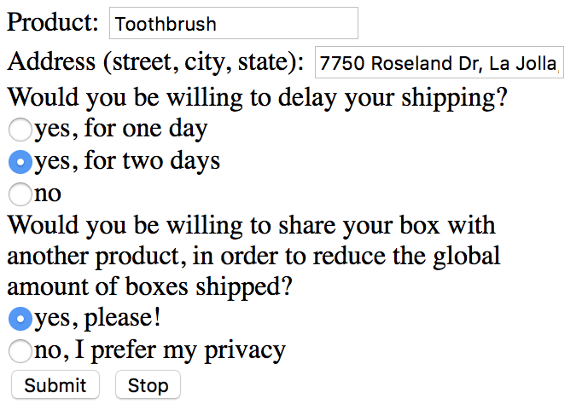
Example
Today’s (12/2) orders:
Will go to general list of 12/4

Slide 17
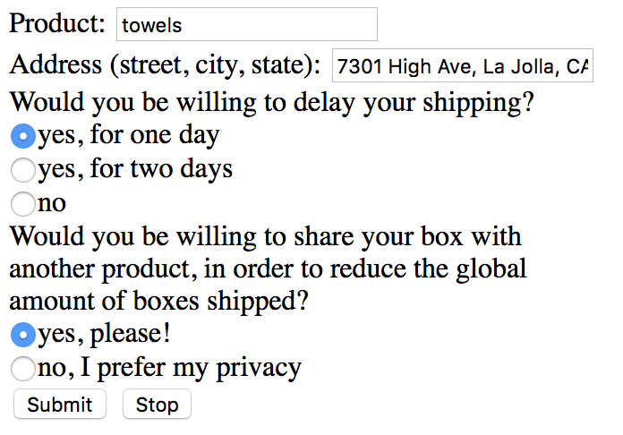
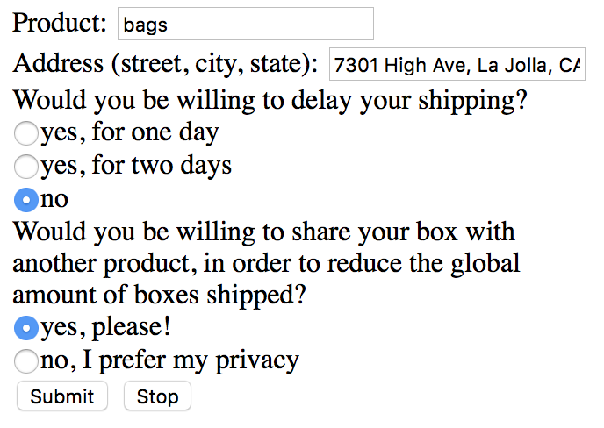
Example
12/3’s orders:
12/4’s orders:
Will go to general list of 12/4
Will go to general list of 12/4
Notes:
La Jolla Country Club

Slide 18
Example
In summary, 12/4 general (non-private) orders:
But these two were not private & same location:
same box! (and same shipment location)
→ only two stops in total

Slide 19
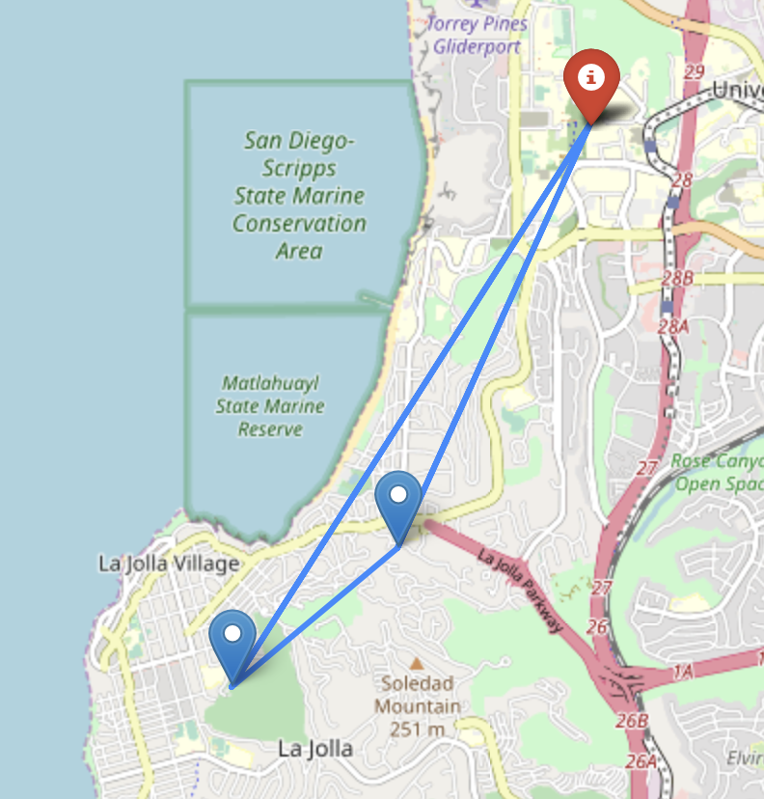
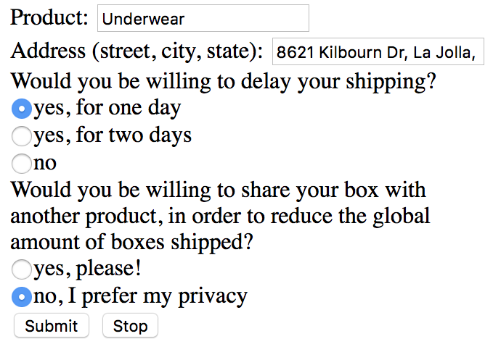
Example
Base
(0),(3)
Voila!
12/4’s most efficient route
Toothbrush (1)
Will go to privacy list of 12/3
Towels + Bags (2)
Notes:
Erased example here

Slide 20
OUR BUILD PROCESS
STEP 1
STEP 2
STEP 3
Get frontend (Flask through Python)
Code algorithm (taking into account all data and finding path)
Implement code & check it works!

Slide 21
Our Struggles
Why Was This Difficult?
Time!
If not for time, we would have learned a lot more about HTML and Python!
UI would be more friendly (input boxes more detailed, text not as bland)
Debugging!
Tough time getting our microframework to initiate (Flask)
Unfamiliar syntax in Python
Notes:
Outline of presentation:
Shocking facts about Amazon/other companies’ shipments.
Stats, photos
Even tho amazon has delay shipping, no one chooses it.
Conclusion: not an efficient system for sustainability
How do we fix it? Core changes: privacy (for boxes), delay via incentive (transportation); took into account distances, time.
Go into each problem and show the code + explain
Hands-on illustration: pass the computer around judges and ask them to input
Then, show the result (picture of pathway)
Explain why result is efficient/sustainable
***if we can’t do hands-on example, just show a mock up example and present the result.

Slide 22
Our Vision
A more efficient global shipment order
Users will always be asked about their privacy and delay preferences
Best route everywhere
Notes:
Outline of presentation:
Shocking facts about Amazon/other companies’ shipments.
Stats, photos
Even tho amazon has delay shipping, no one chooses it.
Conclusion: not an efficient system for sustainability
How do we fix it? Core changes: privacy (for boxes), delay via incentive (transportation); took into account distances, time.
Go into each problem and show the code + explain
Hands-on illustration: pass the computer around judges and ask them to input
Then, show the result (picture of pathway)
Explain why result is efficient/sustainable
***if we can’t do hands-on example, just show a mock up example and present the result.

Slide 23
CREDITS
Flask — The microframework for python we used (FrontEnd)
Google Map Geocoding API — The API we used to calculate distances and times
Python 2.7 — The backbone of our code interpreted and organized user input data
Shoutout to Dillon Hicks and Bassel Hatoum for the tips and check-ins! Thank you!
Shoutout to Stack Overflow for keeping us sane!

Slide 24
WORKS CITED
Favors, Estelle L. “How many boxes does Amazon ship every day?” Quora.com. Quora, 21 March 2017. Web. 1 December 2018.
Jaller, Miguel. “Black Friday Shopping is Terrible for the
Environment. It doesn’t have to be.” Vox.Com. Vox, 21
November 2018. Web. 1 December 2018.

Slide 25
Thank you!
Questions?

